Slide 1

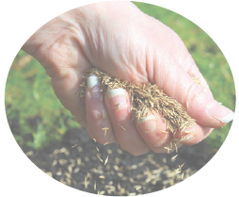
Celebrating the Past and Planting Seeds for the Future
ASSOCIATE SPRING
GATHERING
Saturday, April 6, 2024

Slide 2
Reflection Video
Notes:
(time for reflection)

Slide 3

With the help of God’s Holy Spirit, look back over the past few years to consider the ways in which you:
deepened and widened our SSJ spirituality in relationships with every level of the Joseph family and in partnerships between Christian Growth Groups, the Sisters, and their Sponsored Ministries. Call to mind those who have gifted you, and those whom you have gifted.
Notes:
(time for reflection)

Slide 4
With the help of God’s Holy Spirit…
deepened and widened your SSJ spirituality in relationships with the dear neighbor, those who are marginalized, those who work for justice, and those caring for the earth. Bring these people to mind.
Notes:
(time for reflection)

Slide 5
As you reflect on your ministries, your partnerships, and relationships, what feelings surface in you? Joy? Excitement? Courage? Compassion? Disappointment? Frustration? Something Else? Whatever these feelings are, share these now with God.

Slide 6
Did these feelings draw you closer to God? Did they help you grow in your enthusiasm as an Associate? Was there and experience of transformative grace? While we live our mission of unioning love in the ordinary circumstances of our lives, did they lead you to feel more connected to others and challenge you to live in right relationship?

Slide 7
Look to Tomorrow
How might my presence and participation here today deepen my connections to my SSJ spirituality, Sisters Associates, and the dear neighbor? What grace do I need from God?
Notes:
Close by speaking to God from your heart.
….And to this we say “Amen.”

Slide 8
Table Sharing Reflection Question
What grace(s) have I received as I lived the 2019 Direction Statement?

